Slide 1
Women’s Contribution to Conflict Resolution
Rachel Amram

Slide 2

.
The inclusion of women is vitally needed in resolving conflicts along with the construction of a new society with real equality between the genders. Women’s absence from the official negotiations between Israel and the Palestinians as well as women’s exclusion from other conflict resolution processes, is part of a global phenomenon.

Slide 3

I would like to talk to you about 3 issues:
The significance of women’s inclusion in conflict resolution.
Women's exclusion from conflict resolution processes in Israel although they have been extremely active and were recognized internationally.
The need for gender equality in society to end conflicts in general and in particular - the Palestinian-Israel conflict.

Slide 4

The significance of women’s inclusion in conflict resolution
International relation theories acknowledge that the degree of women’s exclusion from economic and political participation is linked to the degree of unrest. The solution of the Palestinian-Israeli conflict And other global conflicts are linked to restructuring gender relations. Women’s inclusion in Conflict resolution processes means changes in the hierarchy of the patriarchal militarized society in Israel. Women’s inclusion means changing the security discourse during negotiations, to peace and civil discourse. Women’s inclusion in peace-building processes brings stability and moderation, understanding the “other,” consideration of human rights, and social-economic human condition

Slide 5
Evidence show vital need for women inclusion in resolving conflicts, along with the construction of a new gendered society.
One evidence is of the MARWOPNET, a joint peace initiative by the women in the Mano river region in Africa (Liberia, Sierra Leone and guinea), who prevented the outbreak of hostilities among the three countries. They brought the region-leaders back to the negotiating table to solve the problem of the unprecedented killing and flow of refugees from Liberia and Sierra Leone into guinea.
The other evidence is the northern Ireland women's coalition which also played a major role in signing both the Belfast Agreement and the Good Friday agreement, thus ending decades of conflict and hostility in Northern Ireland and Ireland. The women played a major political role in the northern Ireland peace process in their principal objection to the use of force in the conflict. Unlike these evidences that prove women's vital need for ending decades of conflict - the case of women’s participation in conflict resolution process in Israel is different - women were excluded from the process of this on-going conflict although they have been extremely active and were recognized internationally.

Slide 6
Women's exclusion from conflict resolution processes in Israel although they have been extremely active and were recognized internationally.
Like many other national organizations, the Israeli state started by giving women an opportunity to be part of the collective identity. But in reality, women were not part of the decision-making bodies ever. The feminist movement in Israel, first started as a movement to promote women’s equal rights, but soon feminists started to argue very clearly that the struggle for equality is equally sensitive to the Palestinian struggles. This approach is missing from Israel's official negotiations with the Palestinians.

Slide 7

.
A sharp gender gap was encouraged by the Israeli state’s demographic needs, religious rules, and an ongoing conflict which included an aggressive militarized masculinity.

Slide 8

.
Although the Israeli women’s movement has tried to fight their exclusion from public life and made important achievements in regards to the Palestinian-Israeli conflict, it did not help the overall picture: only 26 women serve in the Knesset (the Israeli parliament) today out of 120 Knesset members; women representation is 22%.

Slide 9
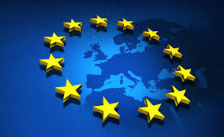
.
Although Palestinian and Israeli women were the first to have peace meetings, they were never included in the formal negotiations when they started. In 1989, Israeli law did not permit Israelis to meet with the Palestine liberation organization, but Simone Susskind, of the European union in Brussels, recruited 150 women leaders from around the Mediterranean, including all the Maghreb countries, Egypt, Jordan and Turkey, as well as Europe and the united states, for a meeting held at the European Union: "give peace a chance, women speak out."

Slide 10

.
A lack of media coverage to peace activities in general and to women conflict resolution activities in particular, is one of the reasons for not recognizing these achievements. The radical left in Israel is enjoying increasing international respect. Almost every Israeli organization promoting peace, conflict resolution and human rights, most of which are women’s organizations, received prizes by different western world organizations. When women in black in Israel was a candidate for the Nobel Prize in 2001, they tried to interest Israeli journalists in the candidacy, and they replied: “now there’s war going on, and this is not the right time to talk about peace”. The media expresses the voices in Israeli society which thinks that there is no time to think of peace, when considering security. But the media and the Israeli society need to ask if conflict resolution should be conducted by soldiers. “Peace isn’t forced by violence,” (professor Noam Chomsky).

Slide 11
The need for gender equality in society to end conflicts in general and in particular - the Palestinian-Israel conflict
The exclusion of women from the public realm affects their lack of influence on the peace processes including the Palestinians-Israeli conflict. Israeli feminists argue very clearly that the struggle for equality is equally sensitive to the Palestinian struggles. This approach is missing from Israel's official negotiations. The two decades after the assassination of Rabin (Israel prime minister) in November 4, 1995 were decades of high hopes that sank to despair. Rabin was a security man and changed his agenda to speak the language of peace. To fulfill Rabin's legacy, there is a need to women's added value to the conflict resolution process.

Slide 12
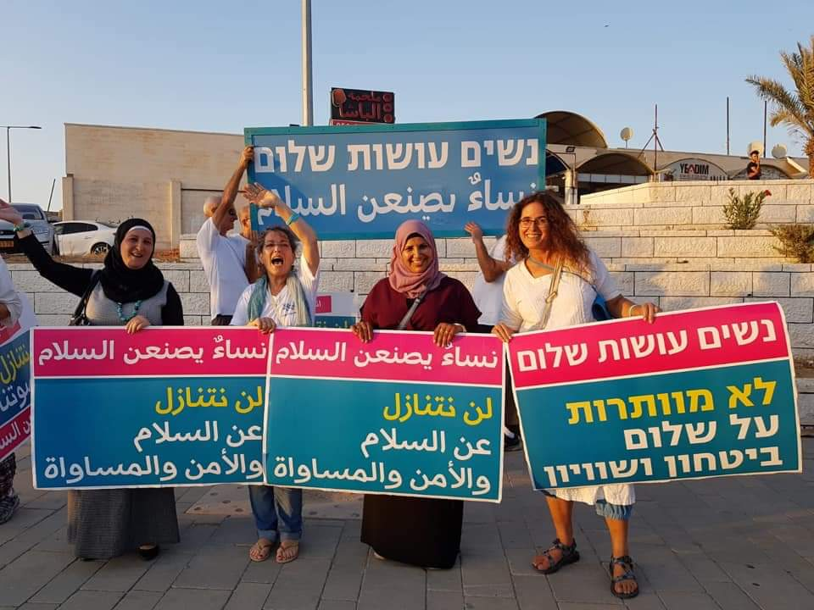
The middle east conflict cannot be solved without the inclusion of women:
Women’s inclusion in the conflict resolution process will moderate the aggression and the violence of the militarized masculine discourse.
The masculine hegemonic elite as well as the general public, need to ask and rethink if conflict resolution is a mission that is appropriate for security and armed forces at all.

